Slide 1
Assessing the Impact of Banning Internal Combustible Engines (ICE) on California Emissions
DATA 621: Fall 2020
Group 3
Zach Alexander, Sam Bellows, Donny Lofland, Joshua Registe, Neil Shah, Aaron Zalki

Slide 2
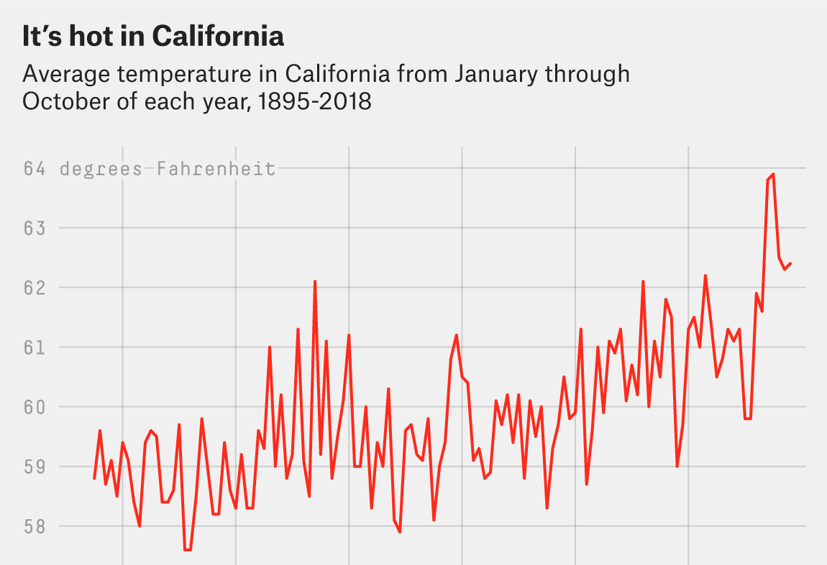
Introduction & Motivation
Climate Change is a top priority in 2020
Economic damage projected trillions per year by 2100
Supported by majority of Americans
California epicenter of climate change
Most populous state
Extreme temperature rises
Propensity for wild-fires

Slide 3
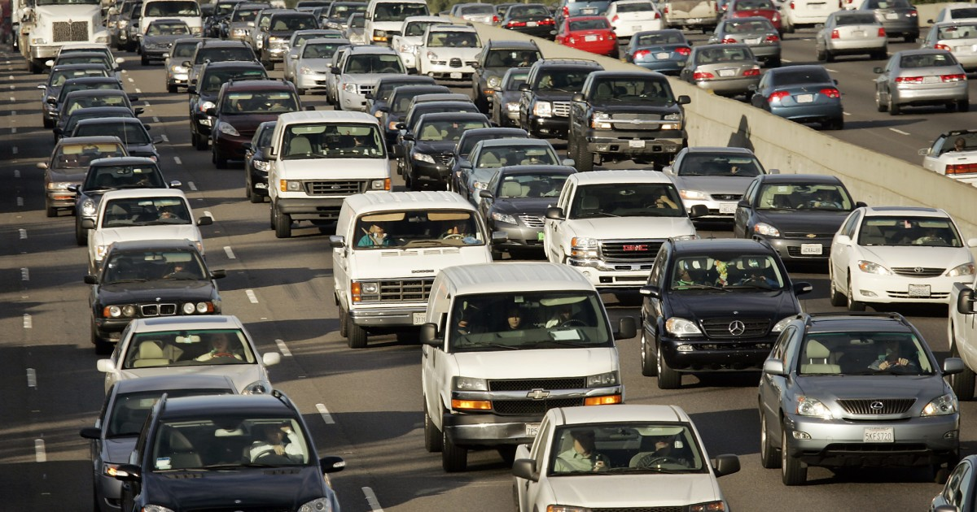
Introduction & Motivation
September 20th, 2020 Governor Newsom bans internal combustible engines (ICE) by 2035; no new sales by 2045
Strongest action by far against climate change
Question
What will be the impacts (quantified) of the ban of gasoline engines do the overall California Emissions?

Slide 4
References
Full GitHub Repo: https://github.com/djlofland/DS621_F2020_Group3/tree/master/Final%20Project
Hope, C., & Alberth, S. (2008). The Cost of Climate Change: What We’ll Pay if Global Warming. NRDC.
Nadia, P. (2020, Feb 20). Climate Change Rises as a Public Priority. But It’s More Partisan Than Ever. Retrieved from New York Times: https://www.nytimes.com/interactive/2020/02/20/climate/climate-change-polls.html
Newsom, G. (2020, September 23). Executive Department State of California: N-79-20. Retrieved from https://www.gov.ca.gov/wp-content/uploads/2020/09/9.23.20-EO-N-79-20-Climate.pdf
Rust, S., & Barboza, T. (2020, September 13). How Climate Change is fueling record-breaking California wildfires, heat and smog. Retrieved from Los Angeles Times : https://www.latimes.com/california/story/2020-09-13/climate-change-wildfires-california-west-coast
Tabuci, H. (2018, April 2). New York Times. Retrieved from Calling Car Pollution Standards ‘Too High,’ E.P.A. Sets Up Fight With California: https://www.nytimes.com/2018/04/02/climate/trump-auto-emissions-rules.html

